Slide 1


High-speed 5G data transmission using Li-Fi technology
Mid-Review 1
Major Project
AY 2021-25
GITAM (Deemed-to-be) University
Project Team:
Niranjan GN
Chavva Hitesh reddy
MunendraKumar
Department of Electrical Electronics and Communication Engineering
Project Mentor:
DR Subhashish Tiwari
Project In-charge:
DR Ambar Bajpai
www.gitam.edu

Slide 2
Objective and Goals
Objective
*Integrate LiFi technology with 5G to enhance high-speed data transmission using visible light communication (VLC) for improved connectivity and performance
*Achieve peak data rates up to 2 Gbps, significantly lower latency, and increased network security through LiFi's unique light-based transmission methods
*Support High User Density: Facilitate connectivity in crowded spaces by offloading data from congested 5G networks, ensuring reliable service for multiple users
Goals
Main Goals
*Reduce Latency: Provide low-latency connections, improving real-time communication for applications
Additional Goals
*Innovate Applications: Enable new applications across various sectors, including healthcare, leveraging the
strengths of both technologies
*Optimize Network Performance: Enhance the efficiency of data transmission by integrating LiFi with 5G, addressing challenges like signal degradation and congestion in high-density areas

Slide 3
Literature Survey
Paper/Study Title | Authors | Year | Key Findings | Challenges/Limitations | Future Scope
Integration of LiFi in 5G Telemedicine Systems | A. Singh, R. Kumar | 2024 | LiFi reduces electromagnetic interference, ensuring secure and high-speed data transmission for real-time telemedicine consultations. | Line-of-sight dependence limits usability in dynamic medical environments. | Optimizing hybrid LiFi-WiFi systems for seamless connectivity in hospitals.
LiFi Technology in Healthcare Environments | J. Brown, P. Lee | 2023 | LiFi offers interference-free operation near sensitive medical equipment, supporting remote monitoring with high-speed connectivity. | Physical barriers like walls or large medical devices obstruct LiFi signals. | Development of multi-user LiFi systems with adaptive beam steering to improve coverage.
High-Speed Communication in 5G Hospitals | M. Ali, S. Patil | 2022 | Successful use of LiFi for high-speed medical imaging transfer and secure patient data transmission in controlled indoor environments. | High initial infrastructure cost and compatibility issues with existing medical systems. | Research into cost-effective LiFi solutions and standardization for hospital adoption.

Slide 4
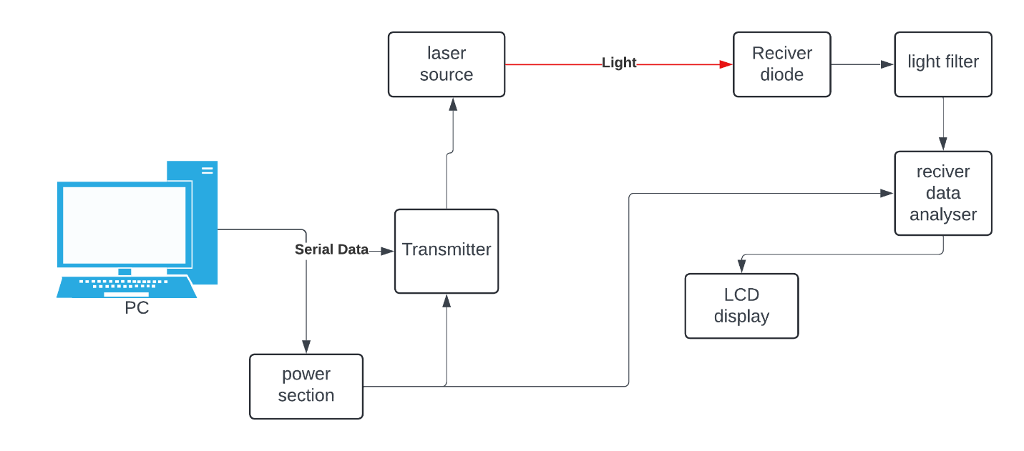
LIFI ARCHITECTURE
LiFi works by using LED light and laser light to transmit data wirelessly through visible light communication. Here is how LiFi works in a nutshell: LiFi operates by adjusting the intensity of light to send data. The technology involves:
- Light Emitting Diodes (LEDs): LiFi systems mainly use LEDs, which can be turned on and off very quickly to encode information.

Slide 5
- Photodetectors: These are used to receive the light signals. The photodetector captures the modulated light and converts it back into electrical signals.
-The diagram you provided appears to represent the **methodology of a Li-Fi communication system**, showcasing how data is transmitted and received through light signals.
1. PC (Personal Computer):
The system begins with a PC that generates data. This data is sent to the transmitter in the form of serial data.
2. Power Section:
The power section supplies the necessary electrical power to the transmitter and other components to ensure proper functioning of the system.
3. Transmitter:
The transmitter receives the serial data from the PC and prepares it to be converted into light signals. The transmitter works with the laser source to modulate the data into light waves.

Slide 6
4. Laser Source:
The laser source is responsible for converting the electrical signals from the transmitter into light signals. These light signals carry the data and are directed towards the receiver.
5. Light Transmission:
The modulated light from the laser travels through the air as the medium. This is the key mechanism of Li-Fi, where light, rather than radio frequencies, is used to transmit data.
6. Receiver Diode:
At the receiving end, a receiver diode (or photodiode) captures the incoming light signal. The diode converts the light signal back into an electrical signal.
7. Light Filter:
The light filter ensures that only the relevant frequencies of light (containing the data) reach the receiver diode, filtering out any unwanted light interference from the surroundings.
8. Receiver Data Analyser:
- The receiver data analyser takes the electrical signal from the receiver diode and processes it back into meaningful data. It decodes the signal to make it understandable for further use.
9. LCD Display:
Finally, the processed data can be displayed on an LCD display or other output devices, allowing the user to view the transmitted information

Slide 7
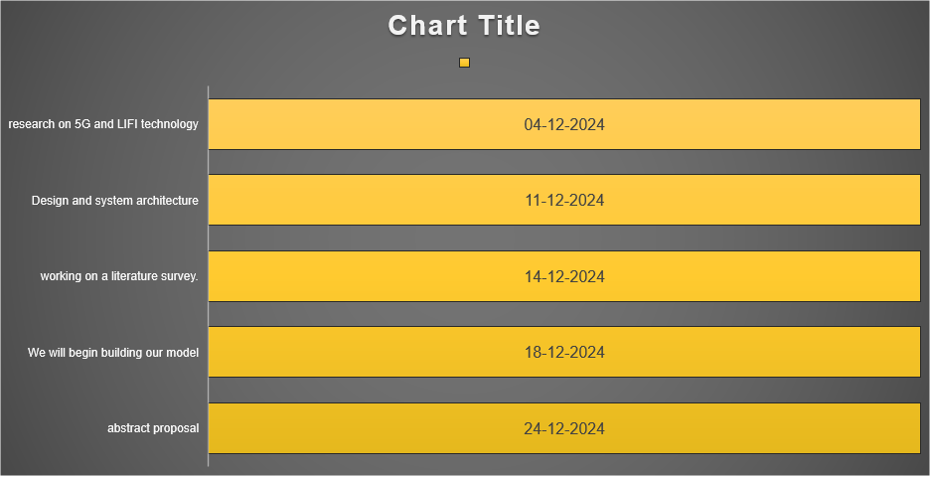
Project Plan (Clearly mention milestone for objectives under each reviews)
Gant Chart - Milestones and Activities

Slide 8
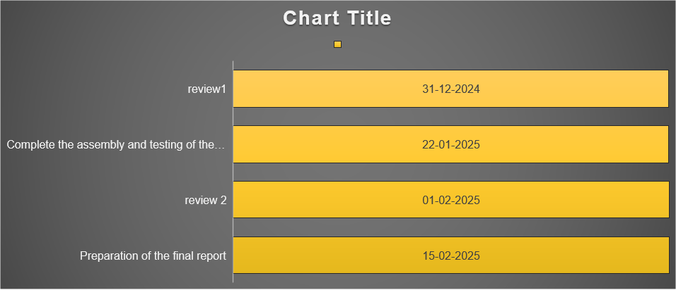

Slide 9
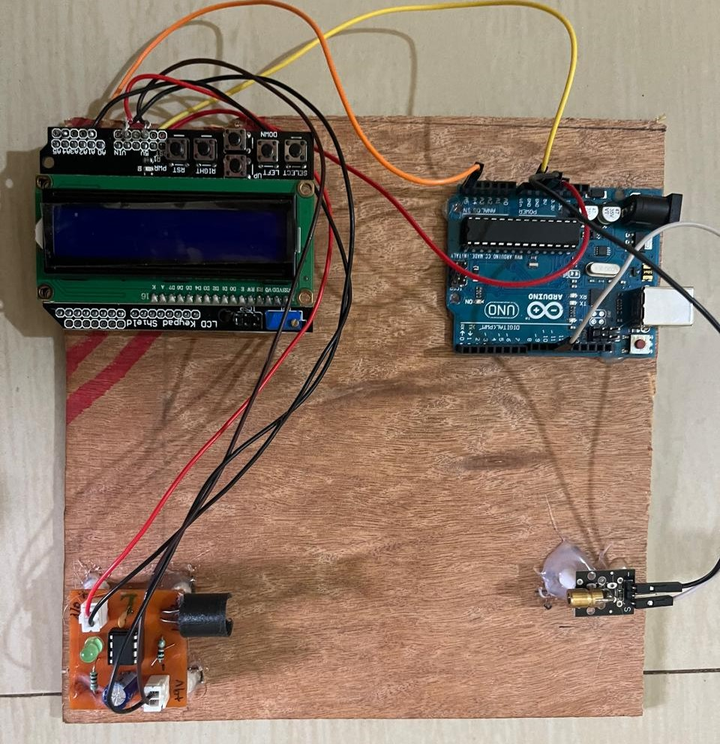
Implementation and Results – Iteration 1
Iteration 1 : Results

Slide 10
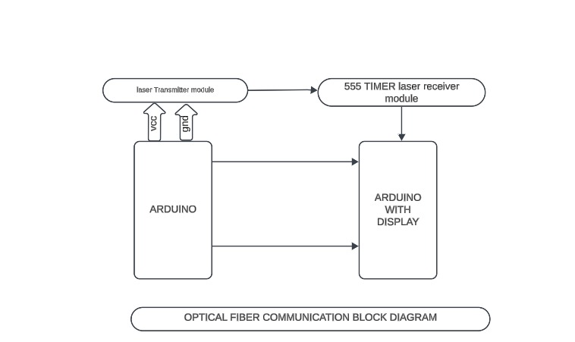
BLOCK DIAGRAM

Slide 11
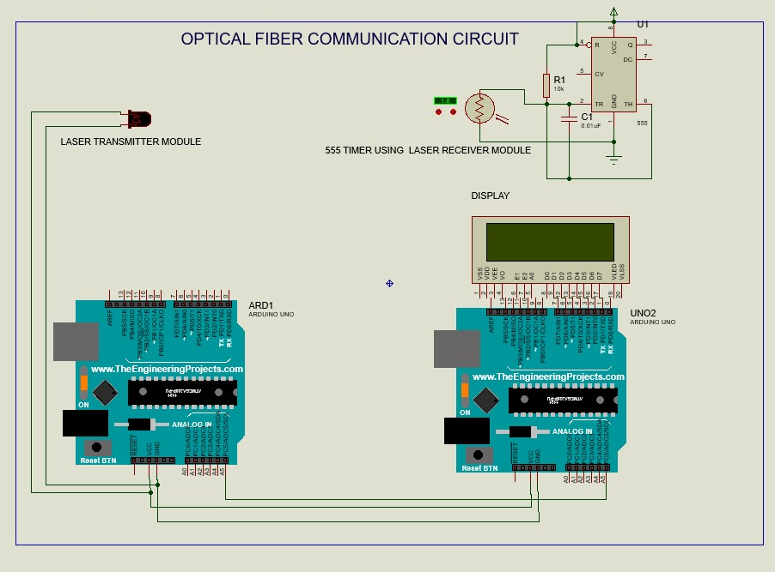

Slide 12
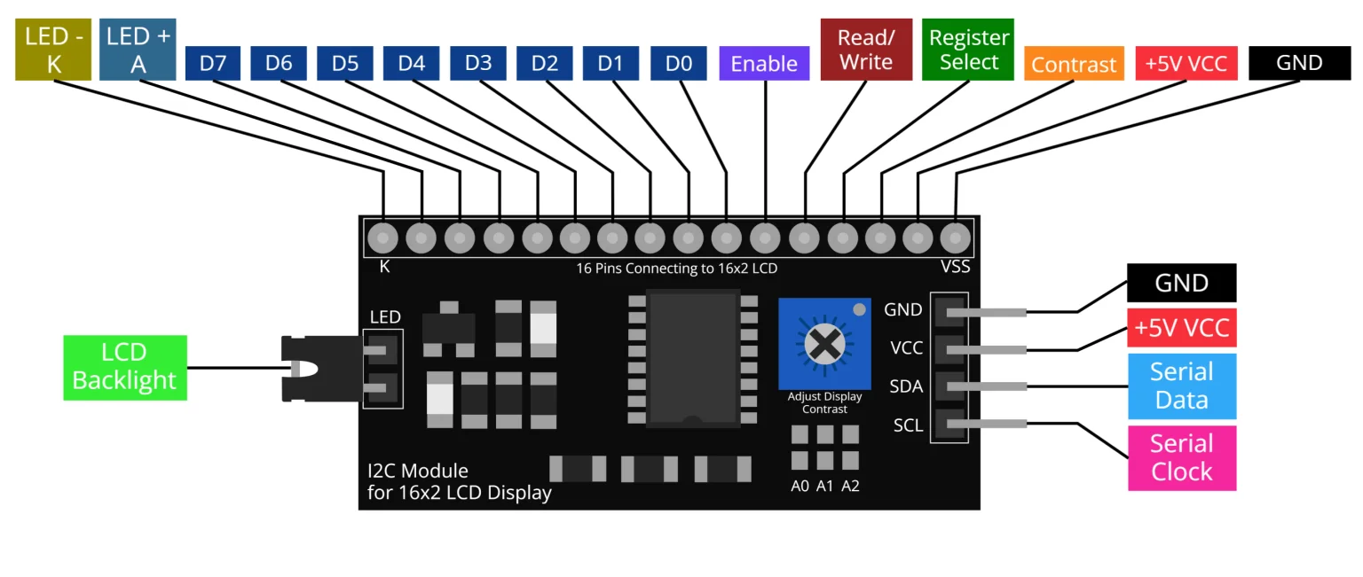
I2C module
Data Transmission:
The system starts with ARD1 (Arduino Uno) sending data signals. These signals are passed to the laser transmitter module.
now we achived the speed of 9600 baud rate
A 9600 baud rate means that the data is being transferred at 9600 bits per second..
The laser transmitter converts the electrical signals into light signals (laser beam), which is then emitted toward the receiver.
Laser Communication:
The laser beam carries the modulated data through the air or optical fiber (as this is an optical communication system).
The 555 timer connected to the receiver side helps control the signal synchronization and timing of the data.
Data Reception:
The laser receiver module detects the incoming light signals (from the laser transmitter) and converts them back into electrical signals.
The received signals are sent to the second Arduino board, UNO2, which decodes the information.
Data Display:
The decoded information is displayed on the LCD screen connected to UNO2. This allows the user to visualize the transmitted data.

Slide 13


Architecture
Instutional type
complete indoor communication system for the future
Lifi routers and LED bulbs
Light reflectors/optical interconnection
Laser transmitter

Slide 14
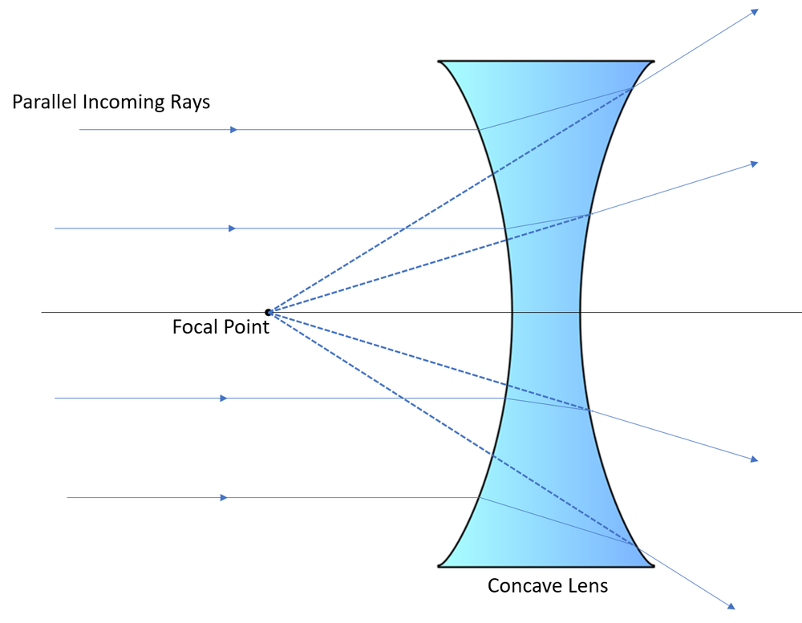
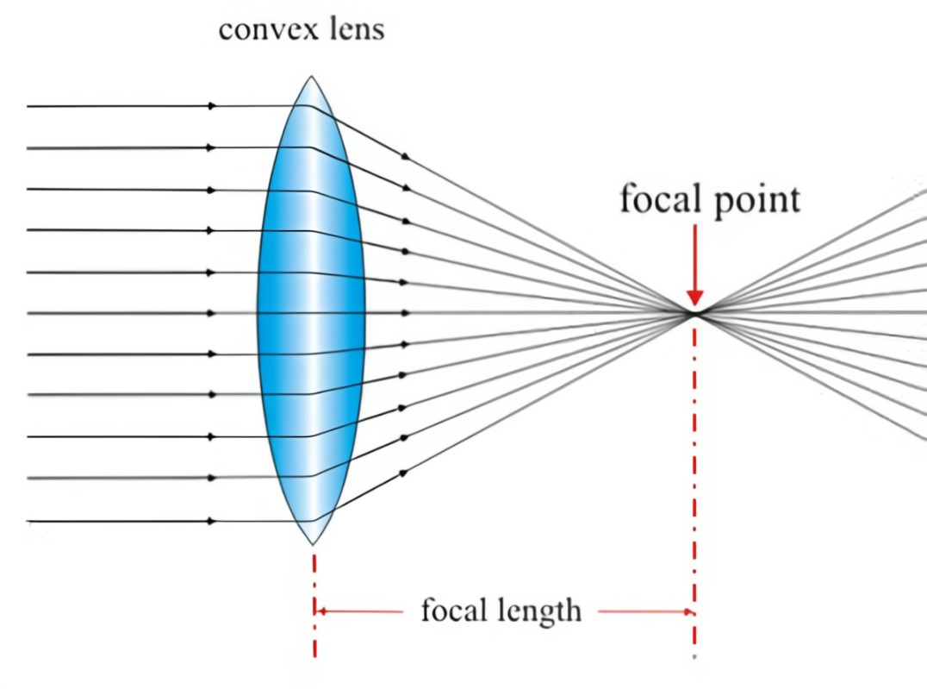

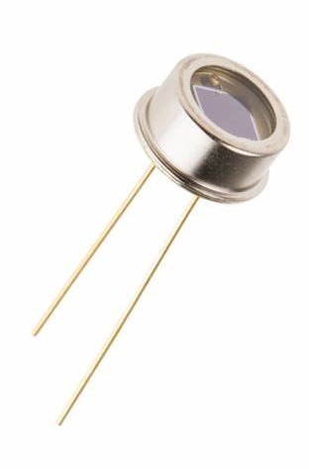
Light reflector module
Laser light
v
towards LIFI router
Laser light

Slide 15



LiFi can indeed be used in the functioning of production line machines and computers.

Slide 16


LI-FI as an important technology for inventory goods management

Slide 17
Challenges & Solutions
Challenges:
Light interference
Limited range
Signal distortion
Solutions:
Use focused LED beams
Improve sensor sensitivity
Implement filters for noise reduction

Slide 18
MODULATION TECHNIQUES USED IN LIFI
Many modulation techniques developed for radio wave communication are adapted for optical wireless communication.
A)Single Carrier Modulation- In this type of modulation
The data is carried by a single main carrier in single carrier modulation techniques, which are more energy efficient than multi-carrier modulation. The most commonly used single carrier modulation techniques for wireless communication are:
- ON-OFF Keying (OOK)
- Pulse Position Modulation (PPM)
- Pulse Amplitude Modulation (PAM)
OOK, also known as Amplitude Shift Keying, is a prominent modulation technique. In OOK, if no signal is transmitted, it indicates a 0 bit, and if a signal is transmitted, it indicates a 1 bit. However, there are two stumbling blocks with OOK:(a) It is sensitive to additive white Gaussian noise.
(b) High data rates cannot be achieved.
In PPM, the amplitude and width remain unchanged, and the position of the pulse varies according to the reference pulse of the input signal. PPM is more power efficient but less spectral efficient than OOK.
PAM maps the signal data for the selection of LED. It is a safe and secure modulation technique in optical communication systems due to the following reasons:
(a) Benefits in less complexity
(b) Flexibility in implementation
(c) Simple structur

Slide 19
B). Multi Carrier Modulation- PPM and PAM are
Not suitable for high data rate ,When the data rate is increased over a LiFi network, all of the previously mentioned techniques will present problems such as non-linear signal distortion and inter-symbol interference, making them unsuitable for high data rates. For this reason, multi-carrier modulation techniques are being highlighted for high-speed communication, as they are more bandwidth efficient compared to single-carrier modulation. The most commonly used multi-carrier modulation techniques for optical wireless communication are Orthogonal Frequency Division Multiplexing (OFDM) and Wavelength Division Multiplexing (WDM)
C). Specific Modulation for LiFiColor Shift Keying (CSK) modulation
is a specific intensity modulation technique used in visual light communication. When white light is produced using yellow phosphor and a blue LED, the LED's switching ability slows down. Another method to produce white light is by using three different LEDs: red, blue, and green. CSK has several advantages over traditional intensity modulation techniques, including:
- Continuous luminous flux and no flickering effects
- Improved LED reliability
This modulation technique also improves data transmission rates compared to other modulation techniques.

Slide 20
Applications & Future Scope
Applications:
Smart IoT devices
Secure data communication
High-speed internet in confined spaces
Future Enhancements:
Increasing transmission speed
Implementing Li-Fi in real-world scenarios

Slide 21
Code explanation
Software part: sender code
#include <SoftwareSerial.h>
#define keyy A4
SoftwareSerial mySerial(10, 11); // RX, TX
void setup() {
// Start serial communications
Serial.begin(9600);
mySerial.begin(9600);
pinMode(keyy, OUTPUT);
digitalWrite(keyy, HIGH);
Serial.println("Type something to send the data in LIFI!");
}
void loop() {
// Send data from Serial Monitor to SoftwareSerial device
if (Serial.available()) {
char inChar = Serial.read();
mySerial.write(inChar);
}
// Send data from SoftwareSerial device to Serial Monitor
if (mySerial.available()) {
char inChar = mySerial.read();
Serial.write(inChar);
}
}

Slide 22
Reciver code
#define LDR_PIN A0 // LDR/Photodiode sensor
#define SPEAKER_PIN 9 // Speaker output
void setup() {
pinMode(SPEAKER_PIN, OUTPUT);
Serial.begin(9600);
}
void loop() {
int sensorValue = analogRead(LDR_PIN); // Read Li-Fi signal
int frequency = map(sensorValue, 0, 1023, 200, 1000); // Convert light intensity to frequency
// Play tone based on received signal
tone(SPEAKER_PIN, frequency, 100);
Serial.println(sensorValue); // Debugging the received signal
}

Slide 23
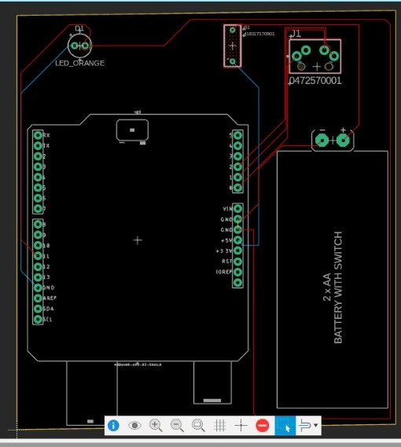
Transmitter Section
Audio transmission using Li-Fi technology

Slide 24
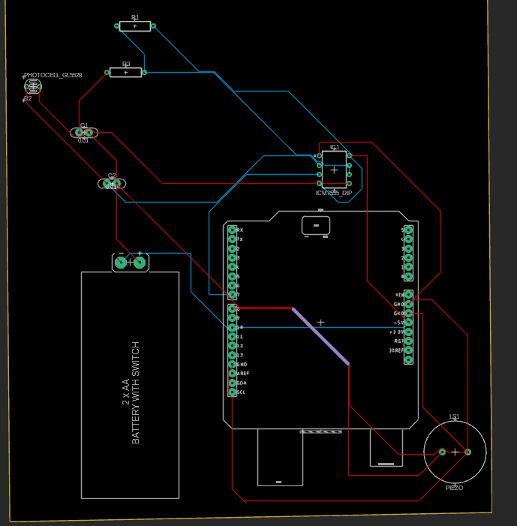
Receiver part

Slide 25
The diverse applications of Li-Fi technology.
1.Defense & Security 🛡️
2.Data transmission is restricted to physical spaces, preventing cyber threats.
4. Industrial Automation 🏭
3.Supports machine-to-machine (M2M) communication in manufacturing units.
Enhances IoT-based real-time monitoring and automation.
5. Aviation ✈️
Provides in-flight high-speed internet without causing interference.
Used for secure communication between cockpit and control centers.
6. Smart Cities & Homes 🏙️
Integrated with streetlights to offer network connectivity.
Supports IoT-based smart home automation.
7. Retail & Shopping Malls 🛒
Helps in indoor navigation and targeted advertising.
8. Underwater Communication 🌊
9. Automobile Industry 🚗
11.Enables vehicle-to-vehicle (V2V) communication for autonomous cars.
Improves road safety with real-time traffic updates.
10. Space Communication 🚀
Potential use in space missions where radio signals are weak.
High-speed data transmission in deep-space communication.

Slide 26
Conclusion
LiFi is a high-speed, secure wireless technology that uses light for data transmission, offering interference-free operation in sensitive environments like hospitals. It ensures fast and safe connectivity for telemedicine and medical applications. However, challenges like line-of-sight dependence and high installation costs limit its adoption. Future improvements in hybrid systems and cost-effective solutions can make LiFi more practical and widely used.

Slide 27


Slide 28
THANK YOU
Have a Great Day !

